Slide 1

SDET Course
Design Patterns - Composite

Slide 2
3 Types of Design Patterns
Creational
Singleton
Builder
Prototype
Factory Method
Abstract Factory
Structural
Adapter
Composite
Proxy
Flyweight
Bridge
Facade
Decorator
Behavioral
Strategy
Observer
Command
Memento
State
Template Method
Mediator
Chain of Responsibility
Interpreter
Visitor
Iterator

Slide 3
Agenda
Description
Diagram
Code sample (Java)
Use cases

Slide 4
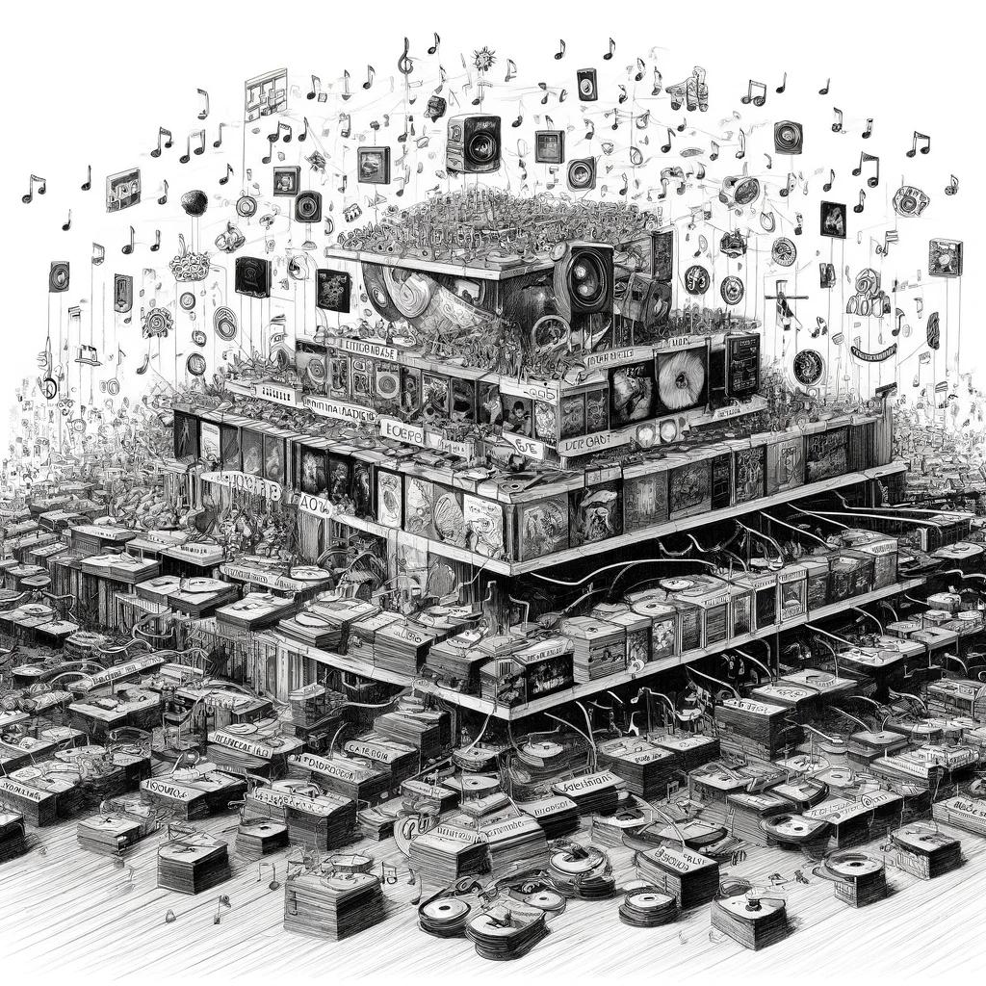
Description
Introduction - Let’s Make a Playlist

Slide 5
The Problem
2 types of elements - Leaf and container
Container contains containers / leafs
Challenge: Generically build / read XML schema
<book>
<title/>
<author>
<firstName/>
<lastName/>
</author>
</book>

Slide 6
Description
The composite pattern describes a group of objects that are treated the same way as a single instance of the same type of object. The intent of a composite is to "compose" objects into tree structures to represent part-whole hierarchies. Implementing the composite pattern lets clients treat individual objects and compositions uniformly.

Slide 7
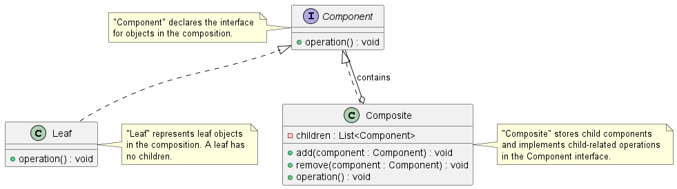
Class Diagram

Slide 8
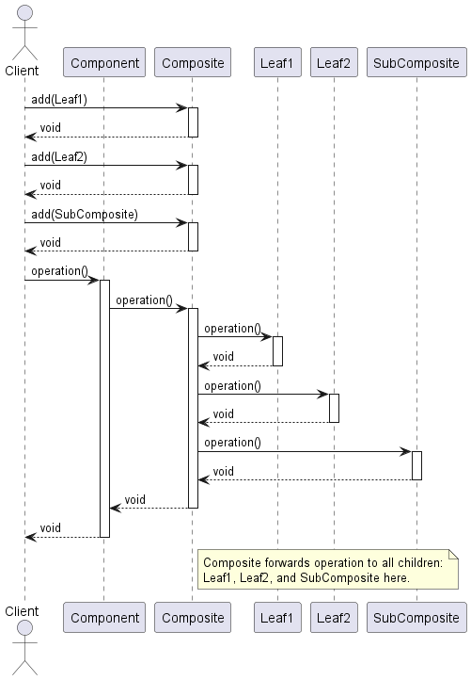
Class Diagram

Slide 9
Code Sample

Slide 10
Use cases
General
GUI Elements
Schema handling (JSON, XML)
File Systems
In Test Automation
Page Objects
Complicated objects (Salesforce, Dynamics CRM)

Slide 11
Happy Coding

